Slide 1




Development of Device for the Estimation of Ambient Temperature by measuring Ultrasonic Propagation Velocity in Air
International Conference On Ultrasonics And Material Science For
Advanced Technology (ICUMSAT-2025)
Saransh*, Nitin Dhiman and P. K. Dubey
Department of Electronics Engineering, J.C. Bose University of Science and Technology, YMCA Faridabad-121006, India
Pressure, Vacuum and Ultrasonic Metrology, Division of Physico-Mechanical Metrology,
CSIR-National Physical Laboratory, Dr. K. S. Krishnan Marg, New Delhi-110012, India
Academy of Scientific and Innovative Research (AcSIR), Ghaziabad-201002, India
*Email: saransh.vas@gmail.com

Slide 2
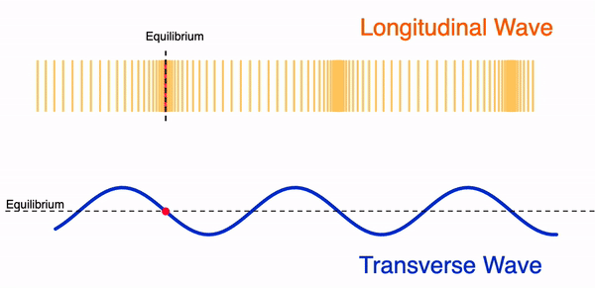
Introduction
What is an Ultrasound ?
You can’t hear it – ultrasound has a frequency above 20 kHz, beyond the human hearing range of 20 Hz–20 kHz.
It needs a medium to travel – ultrasound moves through air, liquids, or solids as mechanical waves.
It reflects back from objects – this echo behavior makes ultrasound useful for sensing, measurement, and imaging.
Longitudinal or Compression Waves
Transverse or Shear Waves
Generation:
Piezoelectric Method
EMAT Methods
Applications:
Calibration
Research and Engineering
Medical
Ultrasonic testing methods:
Single transducer method (Pulse-echo method)
Two transducer method (Through transmission method)
Fig.1 Propagation of waves
Ultrasonic Technique for Temperature Measurement:
Time-of-Flight Method
Measures the travel time of ultrasonic pulses between transducer and reflector
Converts measured time into sound velocity to estimate temperature

Slide 3
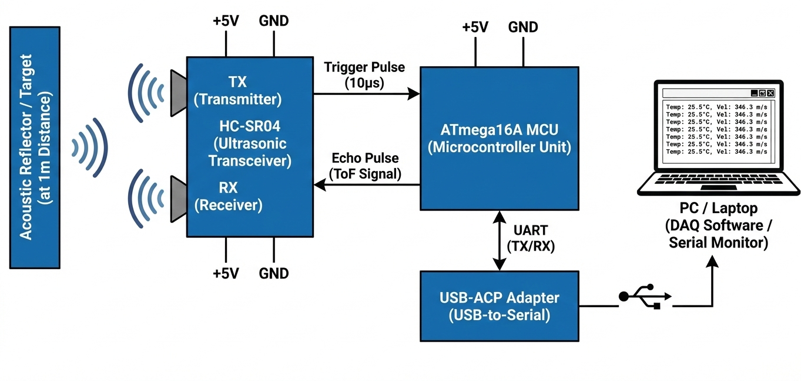
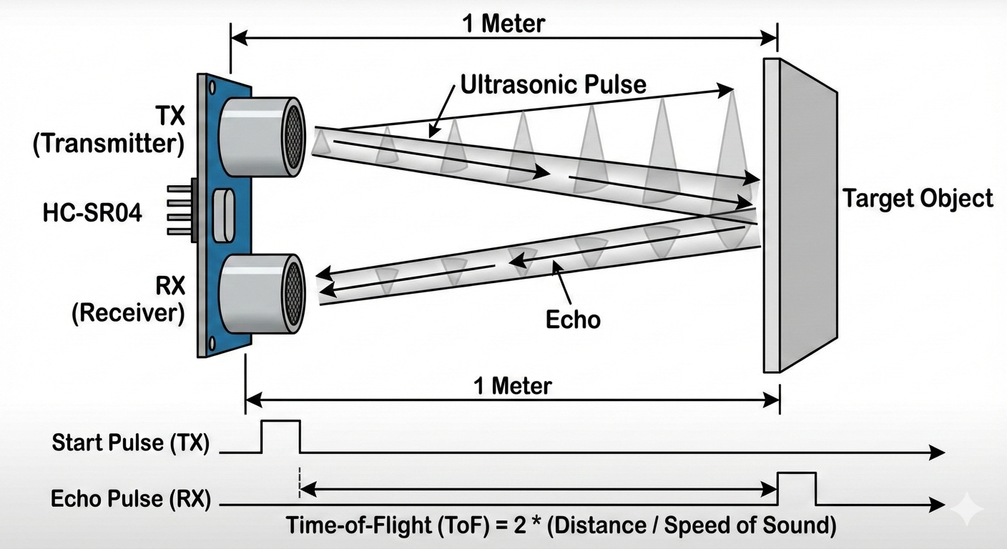
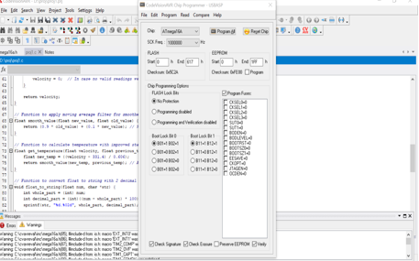
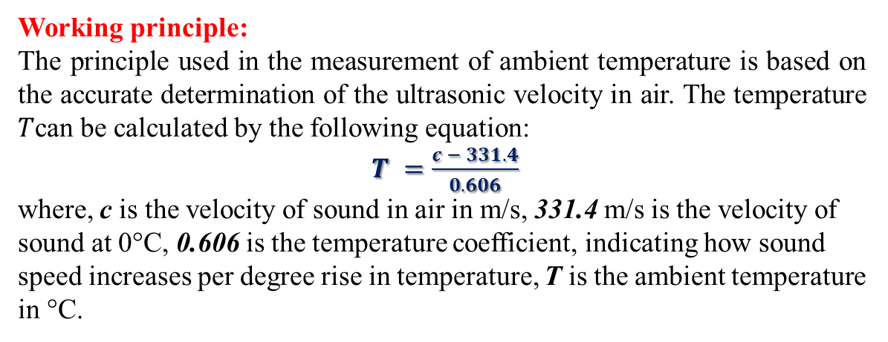
Temperature Measurement using Ultrasonic Propagation Velocity
Working principle:
The principle used in the measurement of ambient temperature is based on the accurate determination of the ultrasonic velocity in air. The temperature $T$can be calculated by the following equation:
$T =\frac{c − 331.4}{0.606}$
where, c is the velocity of sound in air in m/s, 331.4 m/s is the velocity of sound at 0°C, 0.606 is the temperature coefficient, indicating how sound speed increases per degree rise in temperature, T is the ambient temperature in °C.
(1)
Fig.2 Systematic diagram
Fig.3 Representation of system
Fig.4 Software of ultrasonic system

Slide 4
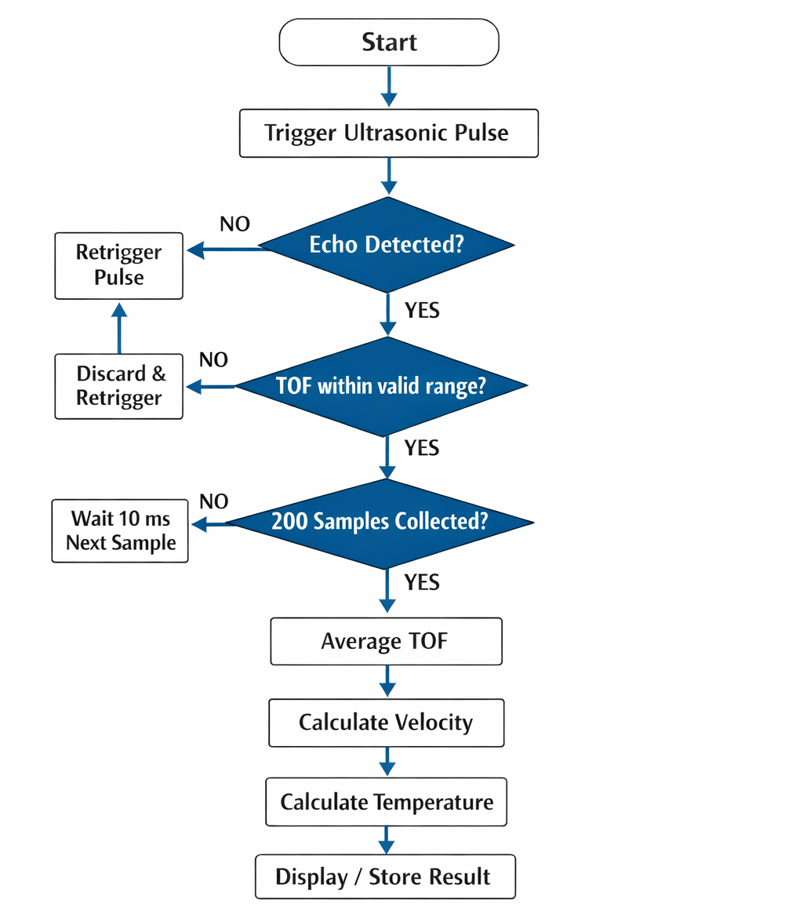
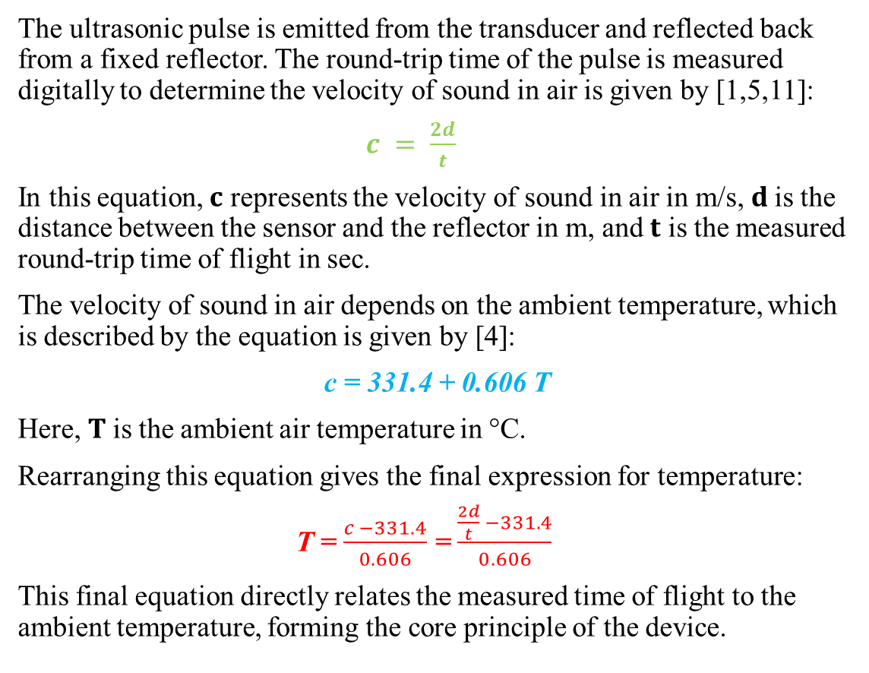
Relationship between Velocity and Temperature
The ultrasonic pulse is emitted from the transducer and reflected back from a fixed reflector. The round-trip time of the pulse is measured digitally to determine the velocity of sound in air is given by [1,5,11]:
$c = \frac{2d}{t}$
In this equation, $c$ represents the velocity of sound in air in m/s, $d$is the distance between the sensor and the reflector in m, and $t$ is the measured round-trip time of flight in sec.
The velocity of sound in air depends on the ambient temperature, which is described by the equation is given by [4]:
c = 331.4 + 0.606 T
Here, $T$is the ambient air temperature in °C.
Rearranging this equation gives the final expression for temperature:
T = $\frac{c −331.4}{0.606}$ = $\frac{\frac{2d}{t} −331.4}{0.606}$
This final equation directly relates the measured time of flight to the ambient temperature, forming the core principle of the device.
(2)
(3)
(Substituting 2 in 3)
Fig.5 Flowchart

Slide 5
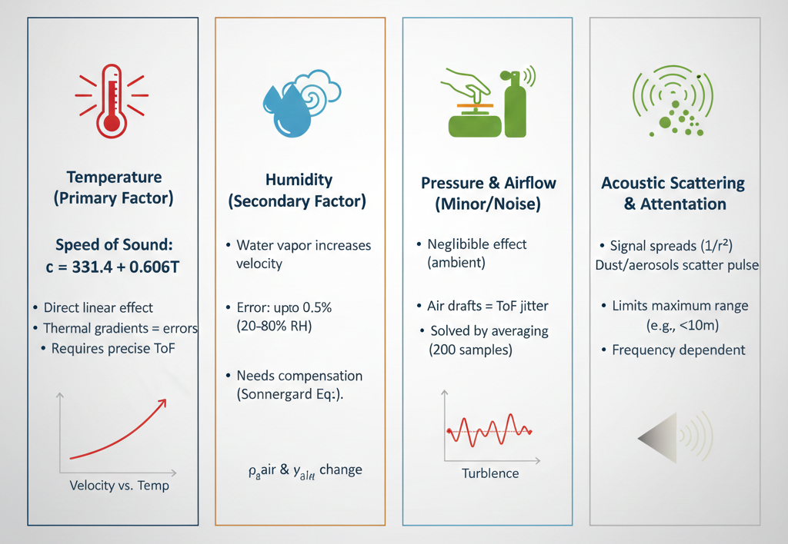
Features, Advantages and Factors Affecting Ultrasonic Velocity
Features: There are many features of ultrasonic temperature measurement. Some of them are:
Real-Time Calculation.
Automated Ultrasonic Triggering
Multi-Sample Averaging
Advantages:
High Accuracy
Easy Integration
Low Cost
Factors which affect the ultrasonic velocity:
Pressure & Humidity
Scattering & Diffraction
Frequency
Attenuation
Fig.6 Factors Affecting Ultrasonic Velocity

Slide 6
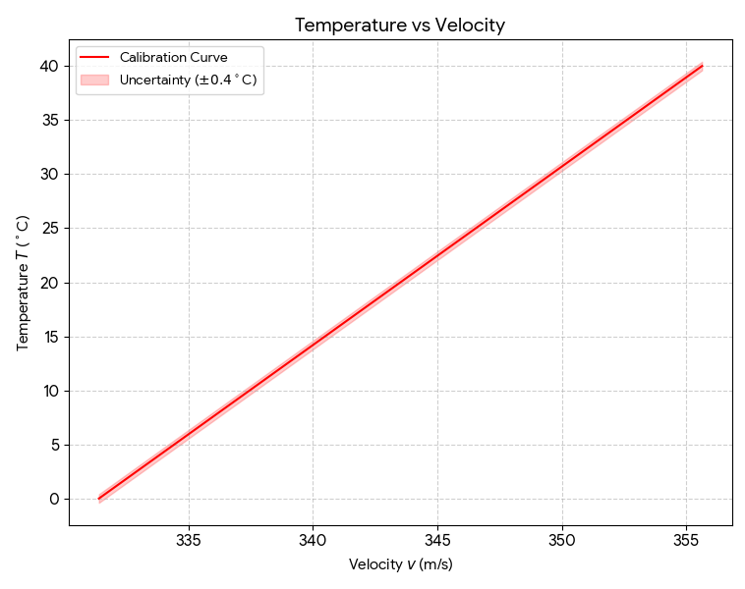
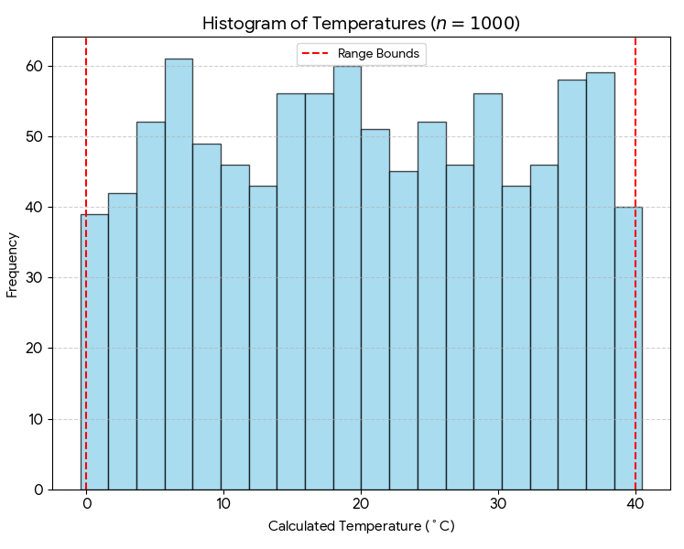
Results
Change in Temperature w.r.t. Velocity
Total Counts w.r.t. Temperature
Fig.7 Graph of measured velocity vs calculated temperature
Fig.8 Statistical Frequency vs calculated temperature
Temperature (T) [∘C] | Velocity (v) [m/s] | Statistical Frequency (Counts) | Uncertainty in T [∘C]
15 | 340.49 | 56 | ±0.4
20 | 343.52 | 60 | ±0.4
25 | 346.55 | 52 | ±0.4
30 | 349.58 | 56 | ±0.4
35 | 352.61 | 58 | ±0.4

Slide 7
Conclusion
High-Precision Temperature Estimation: The system successfully measured ambient temperature by calculating ultrasonic propagation velocity with a ±0.4 °C uncertainty.
Effective Signal Processing: Implementing 200-sample averaging and timing synchronization minimized errors due to environmental noise and sensor fluctuations.
Robust Embedded Implementation: The ATmega16A-based prototype with HC-SR04 and acoustic reflector provided a stable, repeatable setup for real-time measurements.
Practical Applicability: The method demonstrates a non-contact, low-cost, and reliable technique for ambient temperature estimation, suitable for laboratory and industrial settings.
Foundation for Future Innovations: The project establishes a framework for advanced ultrasonic sensing applications, including assistive technology, environmental monitoring, and precision instrumentation.
Real-World Impact: This approach can enhance temperature monitoring in sensitive environments (labs, industrial setups, or clinical settings), reducing manual errors and improving safety and efficiency.

Slide 8
References
[1]. Waveshare Electronics, HC-SR04 Ultrasonic Module Datasheet, 2021. Available: https://www.waveshare.com/wiki/HC-SR04
[2]. Microchip Technology Inc., ATmega16A Microcontroller Datasheet, 2018. Available: https://ww1.microchip.com/downloads/en/DeviceDoc/Atmel-2549-8-bit-AVR-ATmega16A_Datasheet.pdf
[3]. Kinsler, L. E., Frey, A. R., Coppens, A. B., & Sanders, J. V., Fundamentals of Acoustics, 4th Edition, Wiley, 2000.
[4]. Cramer, O., Temperature Dependence of the Speed of Sound in Air, Journal of the Acoustical Society of America, 1993.
[5]. Rahman, A., Precision Distance Measurement Using Ultrasonic Sensors, International Journal of Engineering Research, 2018.
[6]. Banzi, M., Getting Started with Arduino, 3rd Edition, O’Reilly, 2014.
[7]. Regehr, J., Embedded C Programming and the Atmel AVR, 2nd Edition, 2019.
[8]. Patel, R., Calibration of Ultrasonic Distance Sensors for Precision Measurement, Measurement Science Review, 2017.
[9]. Smith, S. W., The Scientist and Engineer’s Guide to Digital Signal Processing, 2nd Edition, 1997.
[10]. Ahn, J., et al., Non-Contact Temperature Measurement Using Ultrasonic Propagation Velocity, Sensors and Actuators A, 2015.
[11]. Waveshare Tech Note: HC-SR04 Timing, 2020. Available: https://www.waveshare.com/wiki/HC-SR04#Timing
[12]. Jones, R., PCB Design for Real-Time Embedded Systems, 1st Edition, Elsevier, 2016.
[13]. Eggers, F., & Funck, T., Ultrasonic Distance Measurement Techniques, Review of Scientific Instruments, 44 (1973), pp. 969–977.

Slide 9


